Slide 1




TIME
MANAGEMENT
Strategies for Success

Slide 2


WHAT IS TIME MANAGEMENT?
Time Management simply means the process of planning and controlling how much time is spent on specific activities.
Effective time management enables you to accomplish more in a shorter period leading to less stress and pressure.

Slide 3


Importance of Time Management
Efficiency: Optimizing time use for maximum results.
Balance: Attaining a balance between work and personal life.
Productivity: Achieving more with better quality.
Stress: Reducing stress through effective planning.

Slide 4


BARRIERS TO EFFECTIVE TIME MANAGEMENT
1
Procrastination
2
Lack of Clear Goals.
3
Overcommitment and Poor Delegation
4
Distractions

Slide 5
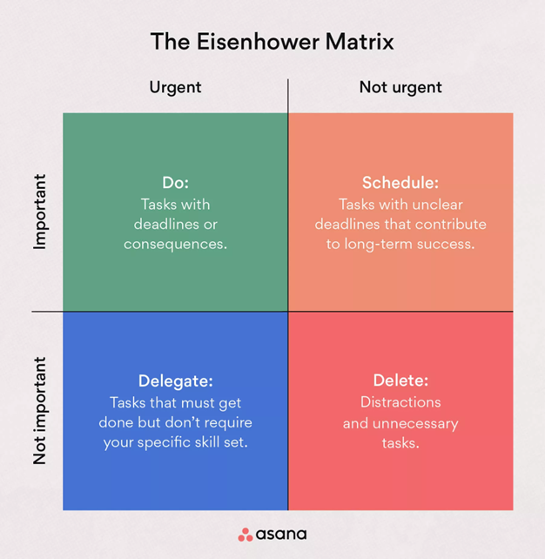
Identifying Priorities
1
Set Goals: Clearly define what you want to achieve.
2
Categorize Tasks: Separate tasks based on urgency and importance.
Use the Eisenhower Matrix: Categorize tasks into four quadrants: urgent and important, important but not urgent, urgent but not important, and not urgent or important.
3

Slide 6




Planning Techniques
To-Do List
Calendar
Time Blocking
GTD (Getting Things Done)
Create a list of tasks to be completed.
Schedule time
for tasks and events.
Allocate specific blocks of time for particular tasks.
A method for managing tasks and projects.

Slide 7


Managing Distractions
Identify Distractions: Recognize what frequently disrupts your focus.
Set Time Limits: Allocate specific times to check
emails or messages.
Create a Work Zone:
Establish a distraction-free work environment.
Use the Pomodoro Technique: Work for 25 minutes, take a
5-minute break, and repeat.

Slide 8

Delegation Techniques
Identify Delegable Tasks:
Determine which tasks can be delegated.
Choose the Right Person:
Select someone with the necessary skills and time.
Provide Clear Instructions:
Communicate clear instructions and objectives.
Monitor Progress:
Ensure to track progress and provide feedback.

Slide 9
Evaluation and Adjustment
Review Performance: Assess how well you followed your time plan.
Identify Areas for Improvement: Find areas that need adjustment.
Adjust Plans: Modify your time management plans
and techniques based on the evaluation.
Keep Learning: Explore new techniques and continuously improve your time
management skills.

Slide 10
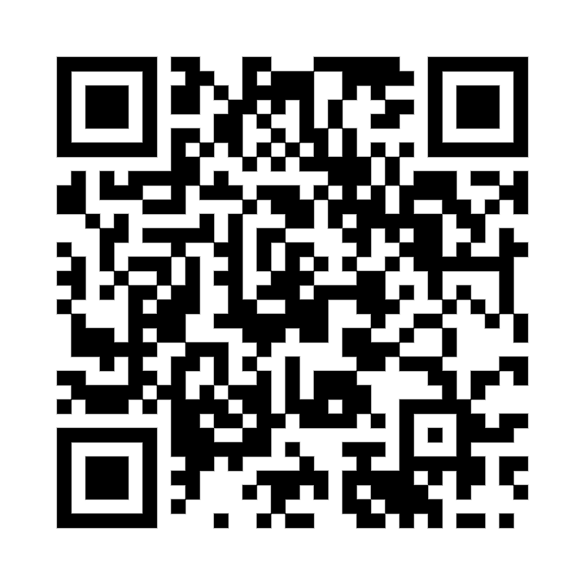
THANK YOU!
Schedule an appointment with a Success Coach for more helpful tips on
Time Management!
220 Lawrence Center
Phone: (610) 436-1067
Email: successcoaching@wcupa.edu

